Slide 1
Kechnovation
Technology meets Innovation
Category - Brand Design

Slide 2
INTRODUCTION
Our Team consists of two people:-
Yash Varshney
Web Designer
Core Developer
MS-Office Expert by Google
Tarang Katiyar
Elementary Web Developer
Professional Designer
Video Editor
We both are from Gurukul The School

Slide 3
OUR DESIGN
02

Slide 4
OUR DESIGN
CosmoRAIL
The name of our product: - CosmoRAIL.
The tagline : - “Ghaziabad accessing faster, cleaner, cheaper”
CosmoRAILS is a futuristic rapid rail system designed to provide efficient and comfortable transportation solutions for commuters and travelers. With cutting-edge technology and sleek design, CosmoRAILS is the future of rail travel.
About Logo: -
The logo of our contest is Designed in Corel 2023(March Release).
The logo is rendered using Corel 2023
Our logo uses a manually integrated font called: - “Bahnschrift - Semi Bold”

Slide 5
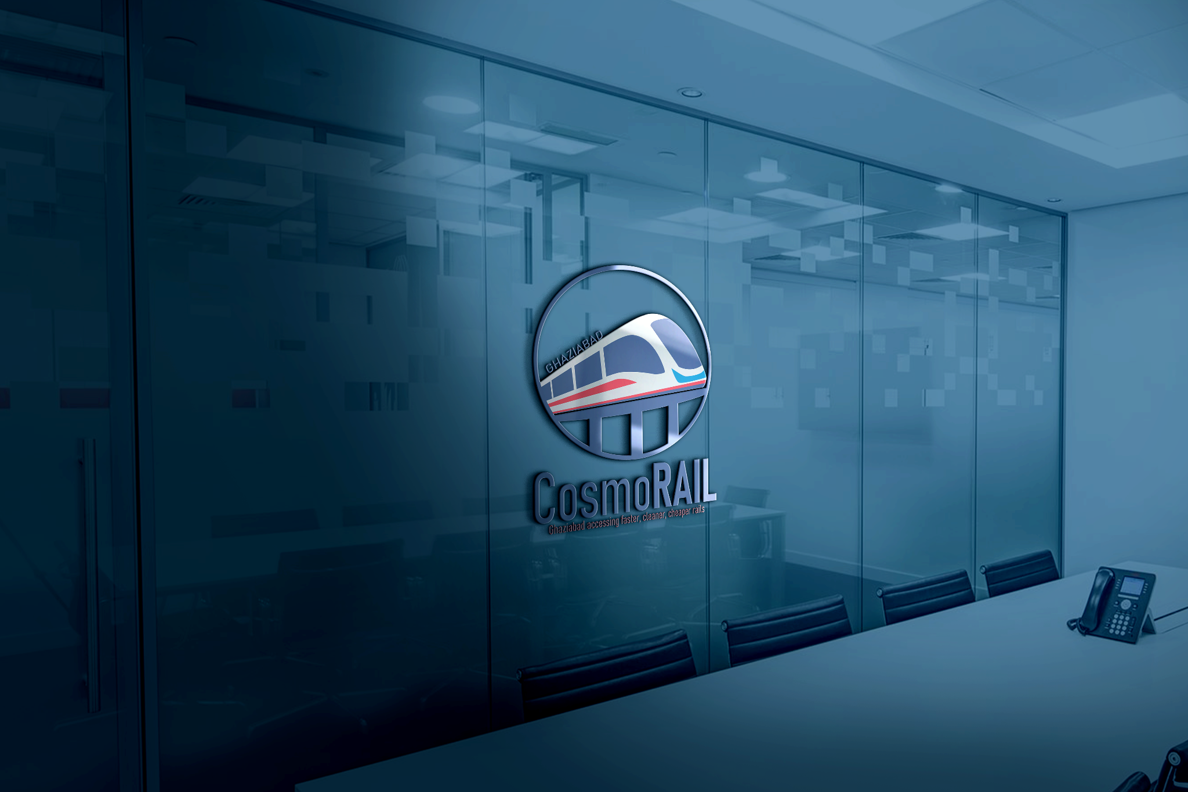

Slide 6
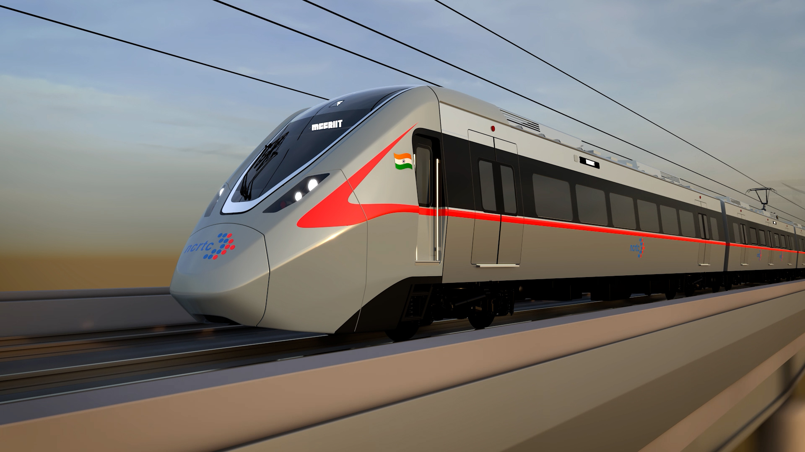

Slide 7
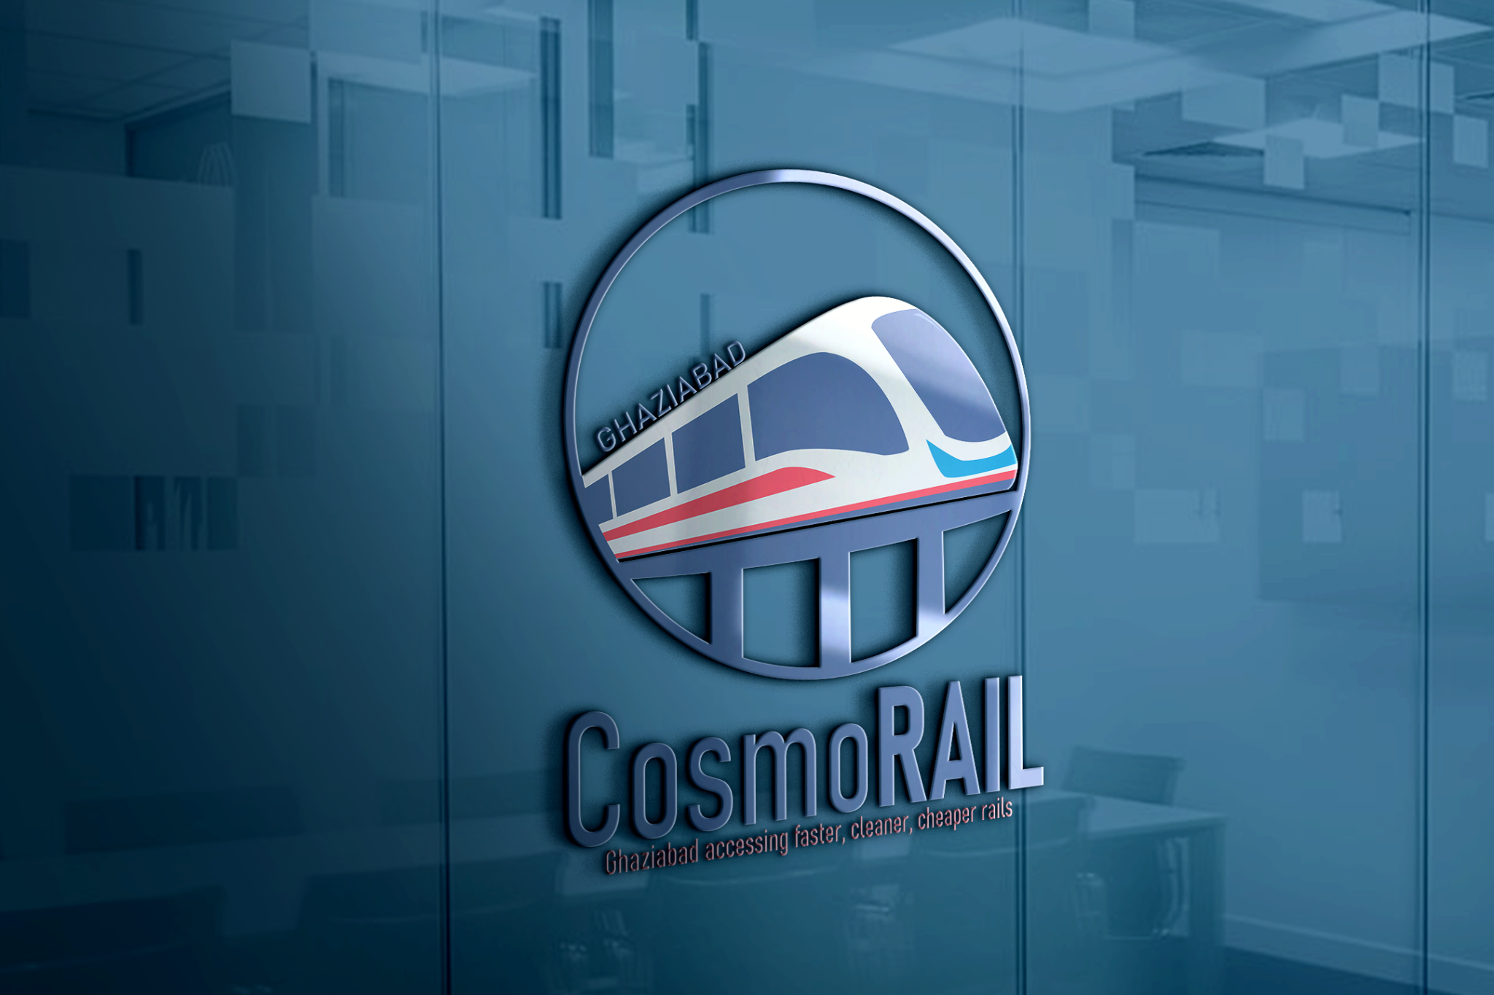

Slide 8
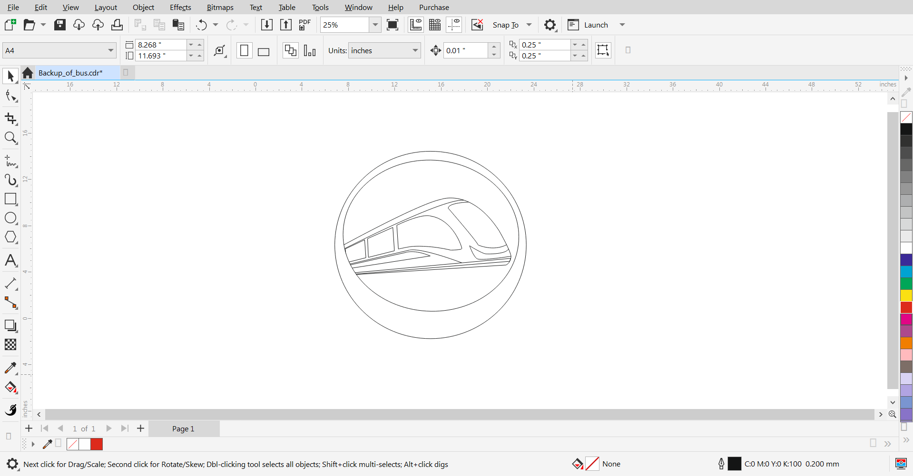
SCREENSHOTS(Structure)

Slide 9
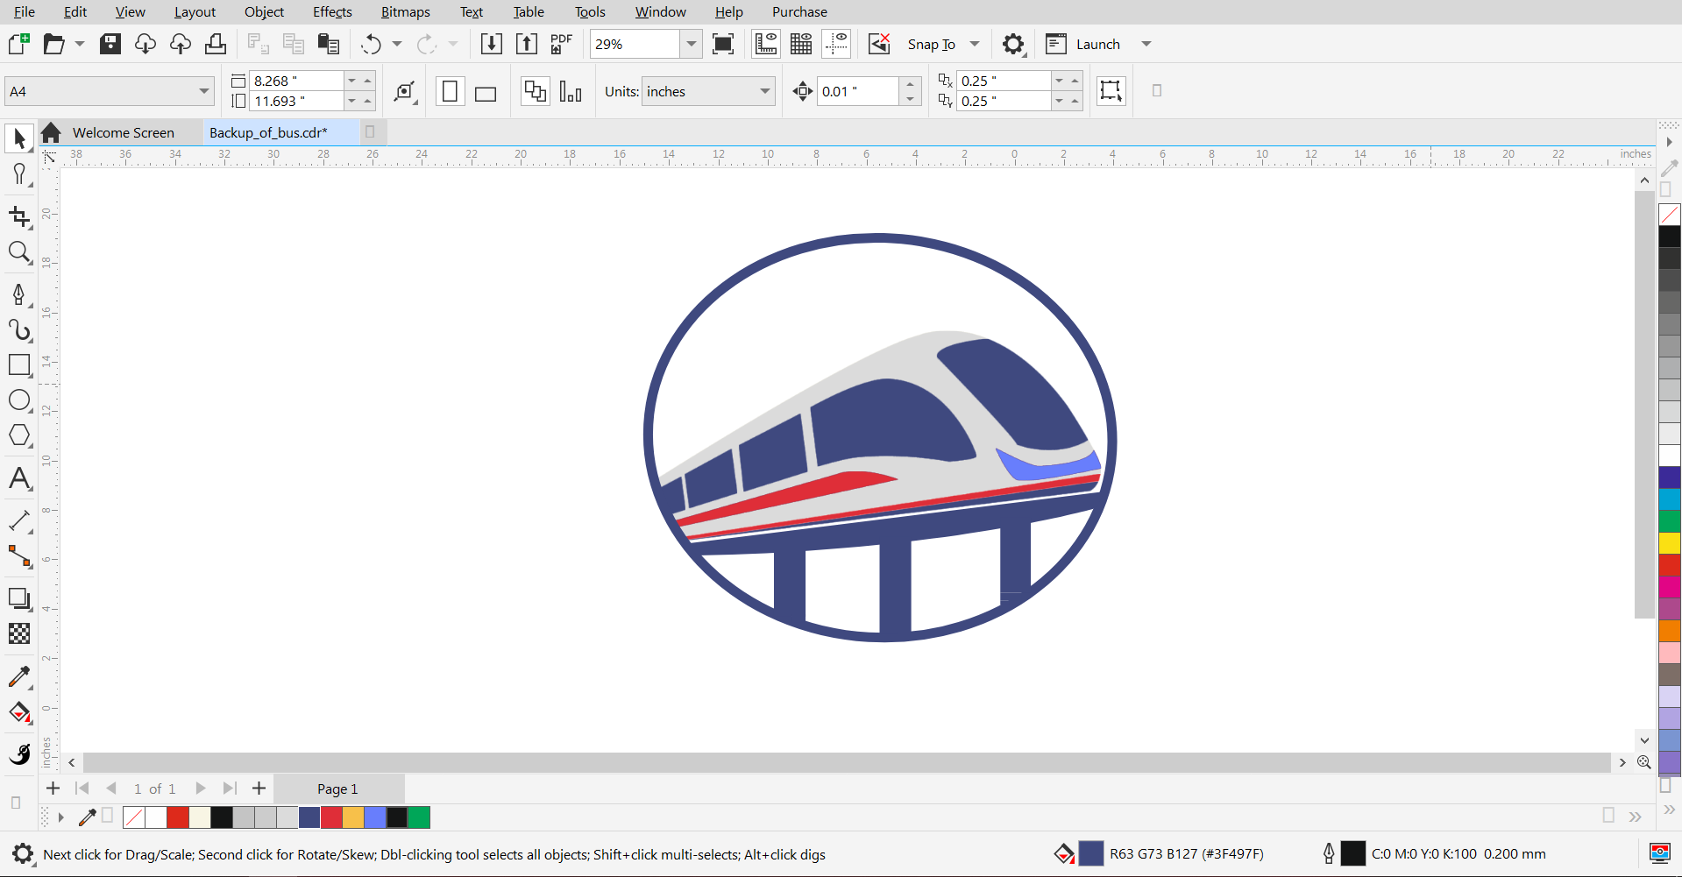
SCREENSHOTS(Filling)

Slide 10
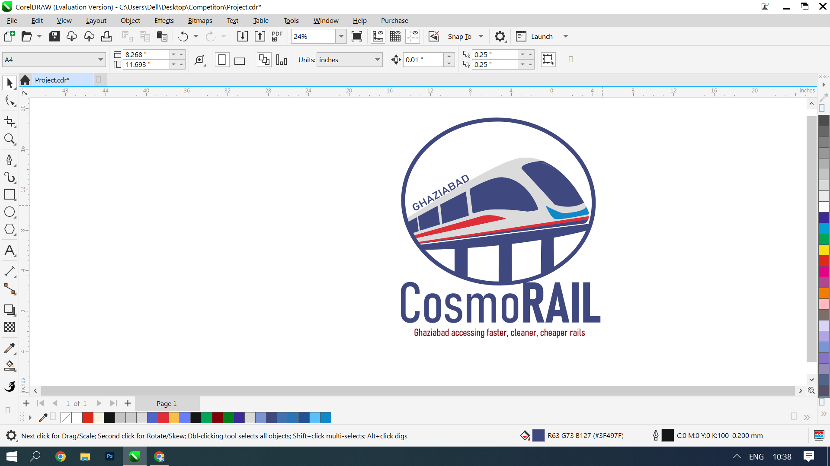
SCREENSHOTS(Adding Text)

Slide 11

SCREENSHOTS(TouchUp)

Slide 12
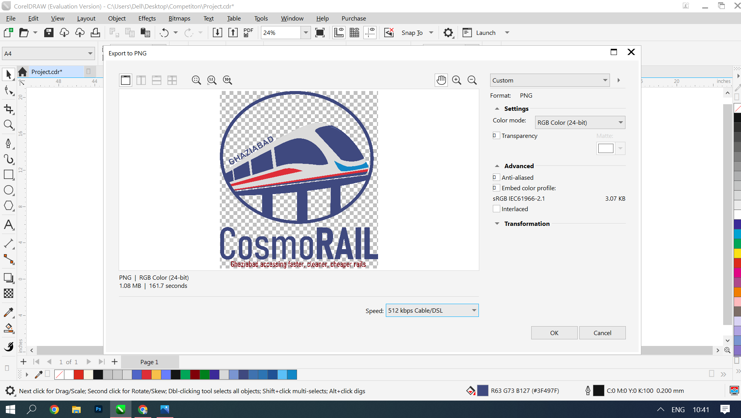
SCREENSHOTS(Export)

Slide 13
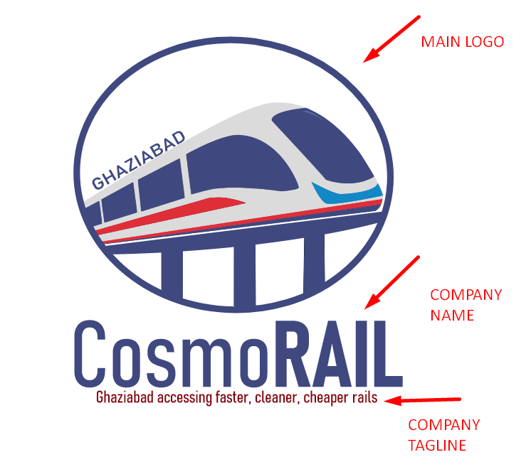

Slide 14
All Exports
All four renders: -
Main_Logo(For Clothing)
Brand_ Name(For Tshirt Branding)
Only_Tagline(For making the notebooks folders etc.)
Full_Logo(For Presenting)
Logo_with_brand_name(for other purposes)

Slide 15
SIGNIFICANCE
03

Slide 16
SHAPES AND STRUCTURE
THE DESIGN INSPIRATION
We have tried to recreate the design and structure of the “India’s First Rapid Rail Transit System Train”.
We have tried to keep the structure identical
THE BRIDGE
The rapid rail system works on the over-bridge system like metro.
It is city-to-city traveller.

Slide 17
SHAPE AND STRUCTURE
THE BRAND NAME
The brand name is - “CosmoRAIL”
The first word is Cosmo which signifies a place where you can travel and also means a city.
The second word is RAIL which simply says Railroad or track
THE HIGHLIGHT OF RAIL
We have highlighted the word rail by using UPPERCASE LETTERS symbolizes the speed and superiority of the project than others.

Slide 18
SHAPE AND STRUCTURE
THE TAGLINE
So the tagline is - “Getting you there faster, cleaner, cheaper”
The three words symbolise the that the rapid train system will be faster, it will do less pollution to the environment because it works on electricity, no fuel-lower costing
THE CIRCLE POWERCLIP
We have powerclip the train inside the circle for giving it the proper shape and increasing its versatility for combining and adding it into the merchandise

Slide 19
COLORS(HUMAN PSYCHOLOGY)
USAGE OF BLUE
Blue is the special color which signifies reliable authority, modernity, futuristic design along with high travelling when paired with red
Blue is used in this project to display travel and futuristic design
USAGE OF RED
Red is the most eye-catching color in the palette of RGBs.
Science says, that red is actually first seen by human because of its vibrance in contrast.
The presence of red in our logo makes the user first see at the train and its details rather than the logo text or anything else!

Slide 20
COLORS(HUMAN PSYCHOLOGY)
USAGE OF DULL LIGHT BLUE
Dull Light blue color signifies a very important trait of the electrical train which is calmness.
The electric train actually produce very low sound while moving making the environment peaceful inside and outside as well
USAGE OF DULL DARK RED
Dull dark red is the color that is 70% less visible then the actual red color itself which makes it the perfect choice as we don’t want to pop out the tagline.

Slide 21
MERCHANDISE
04

Slide 22
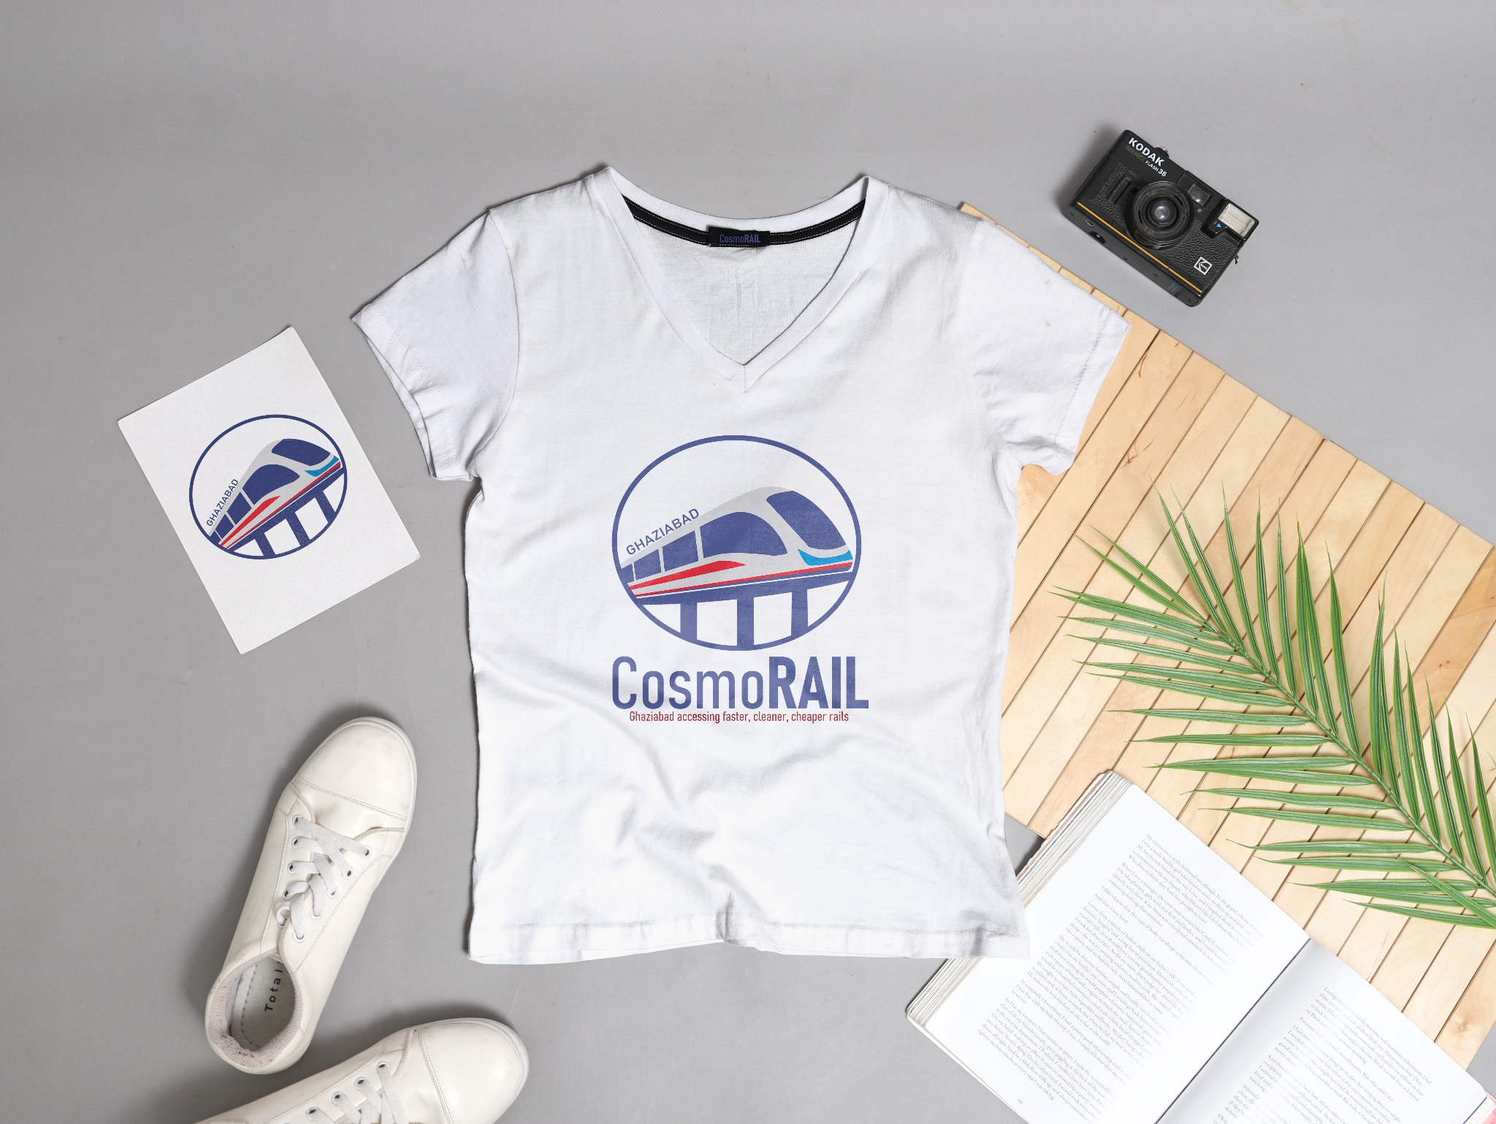

Slide 23
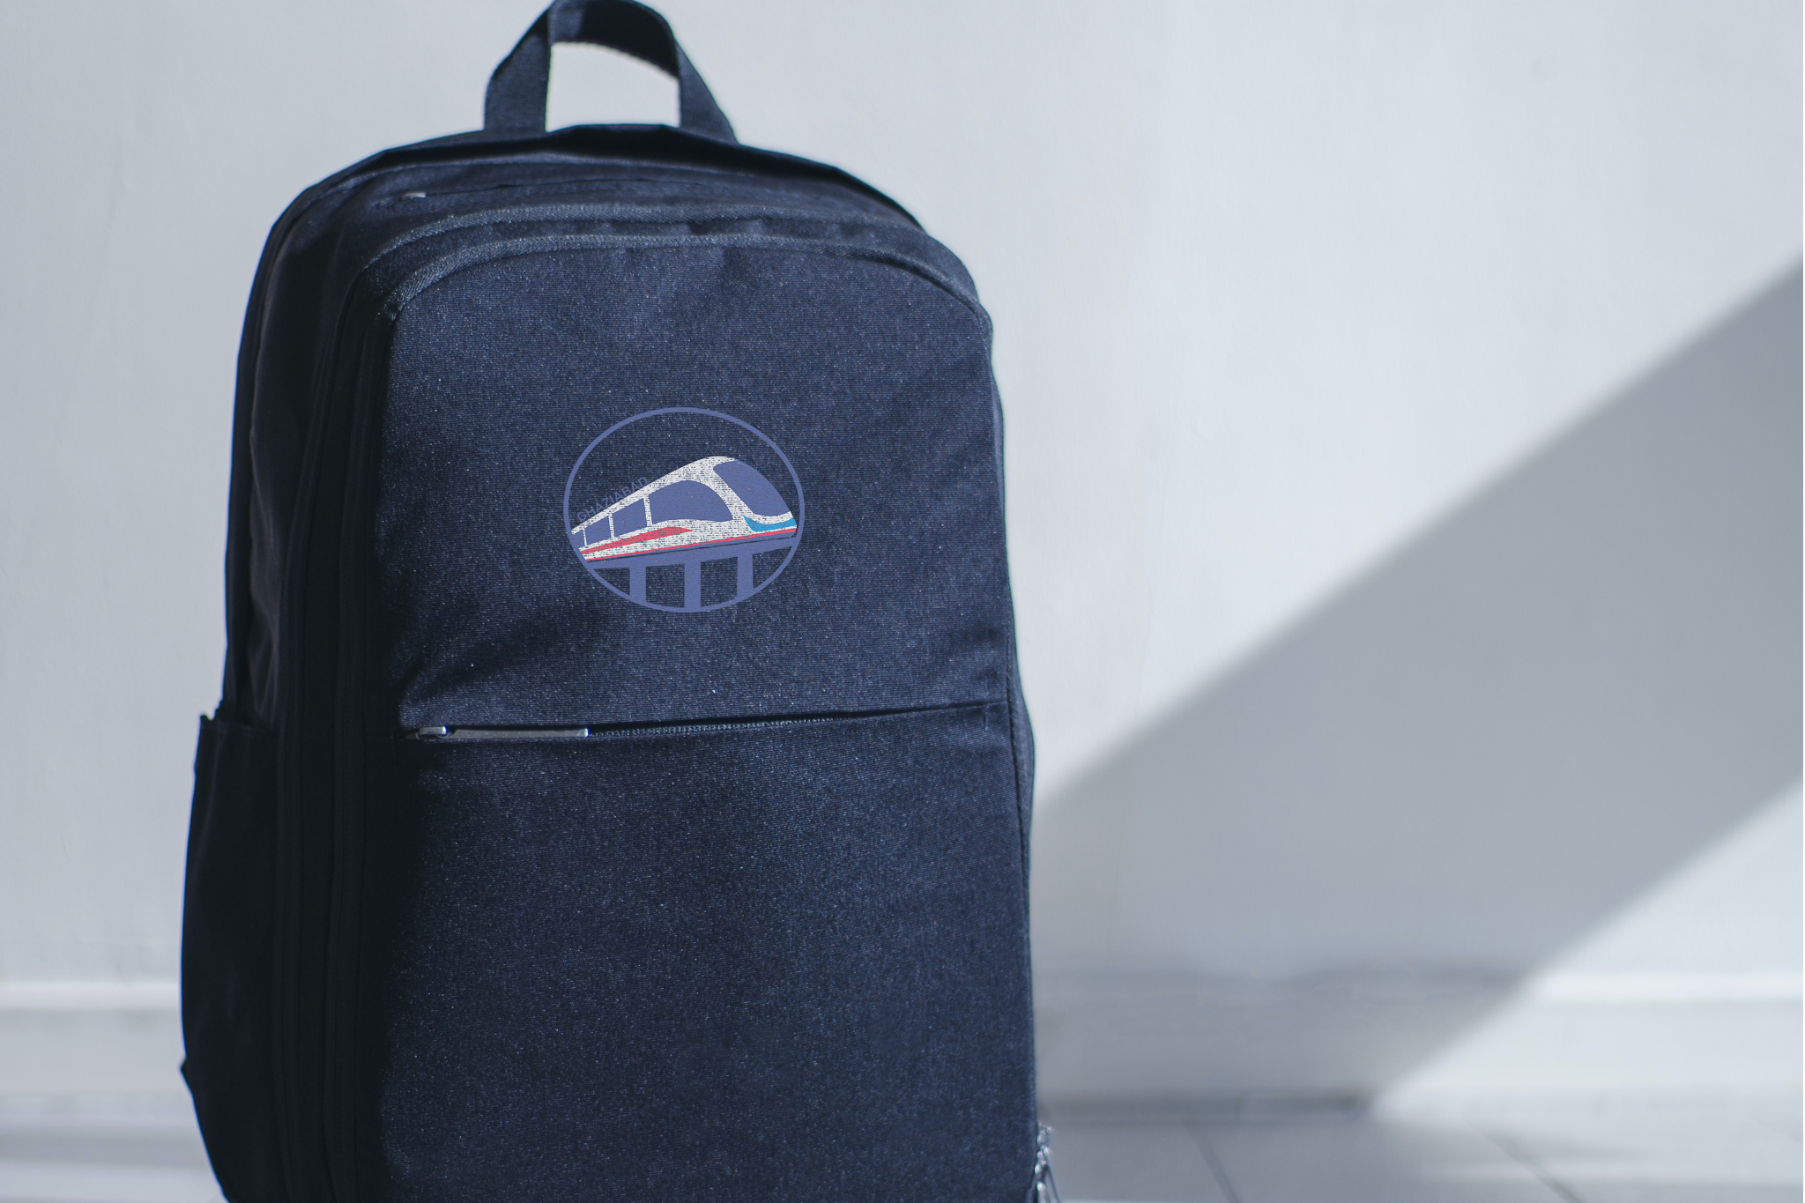

Slide 24
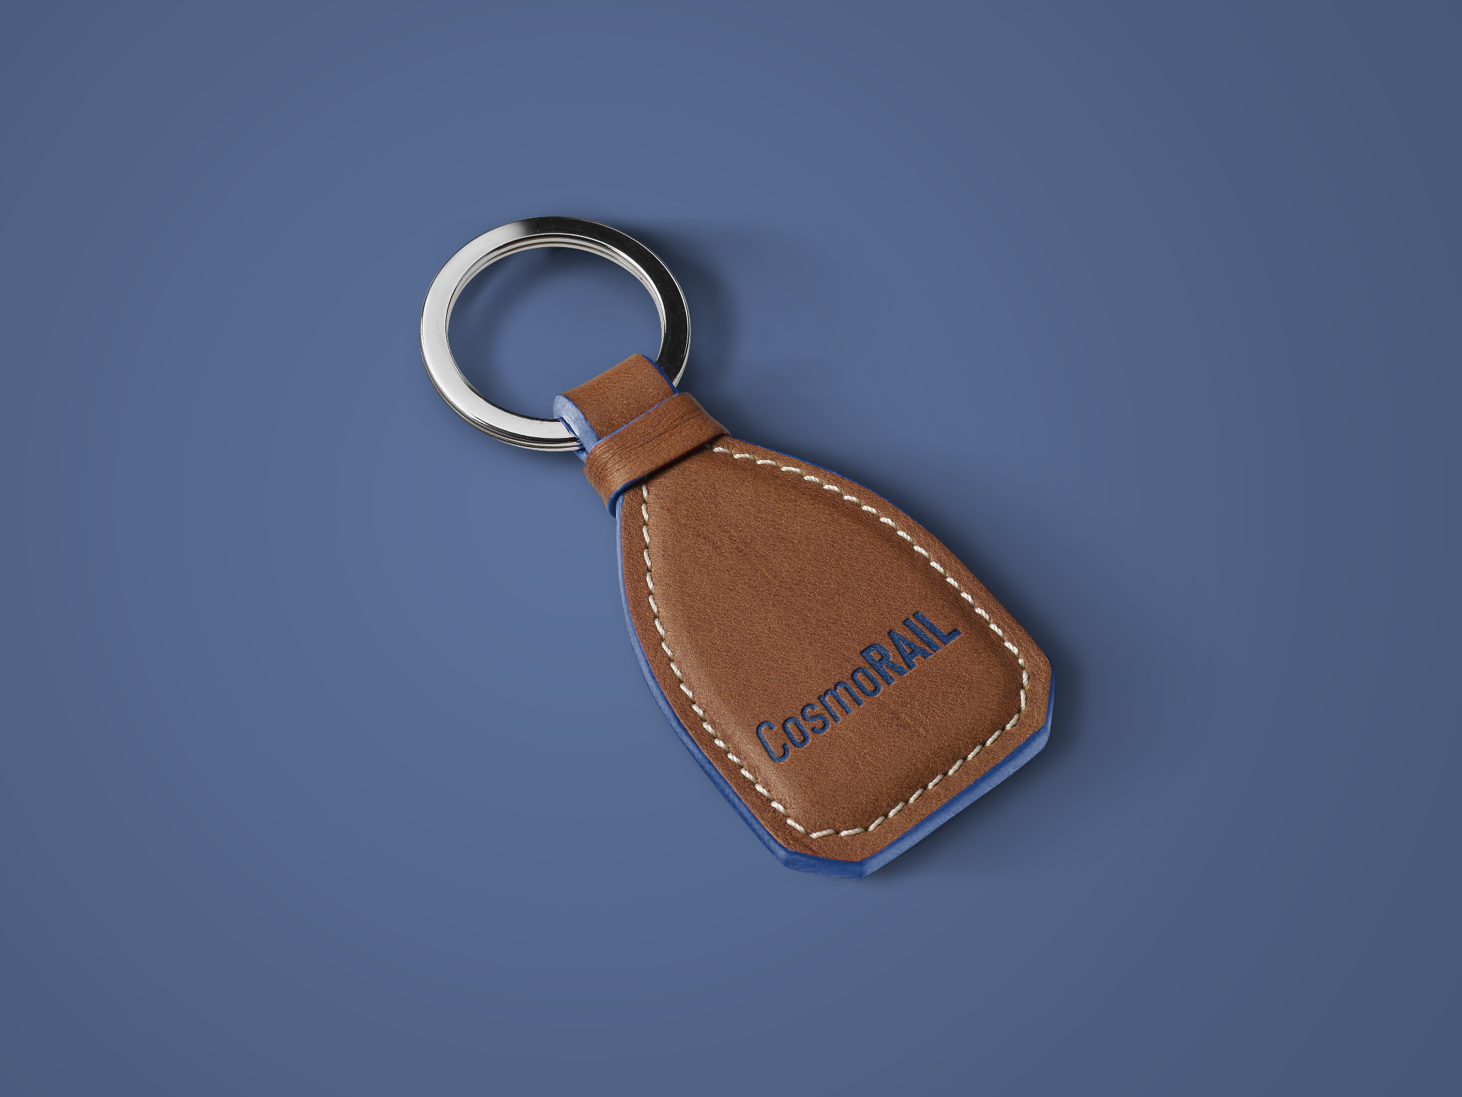

Slide 25
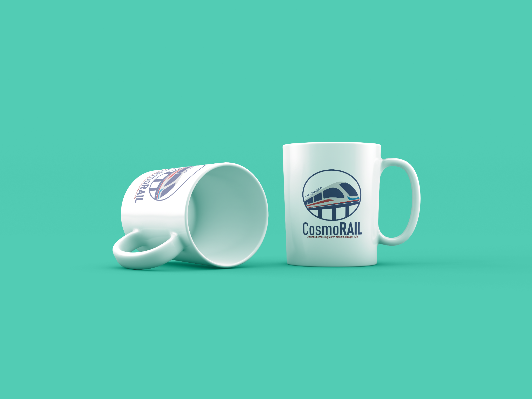

Slide 26
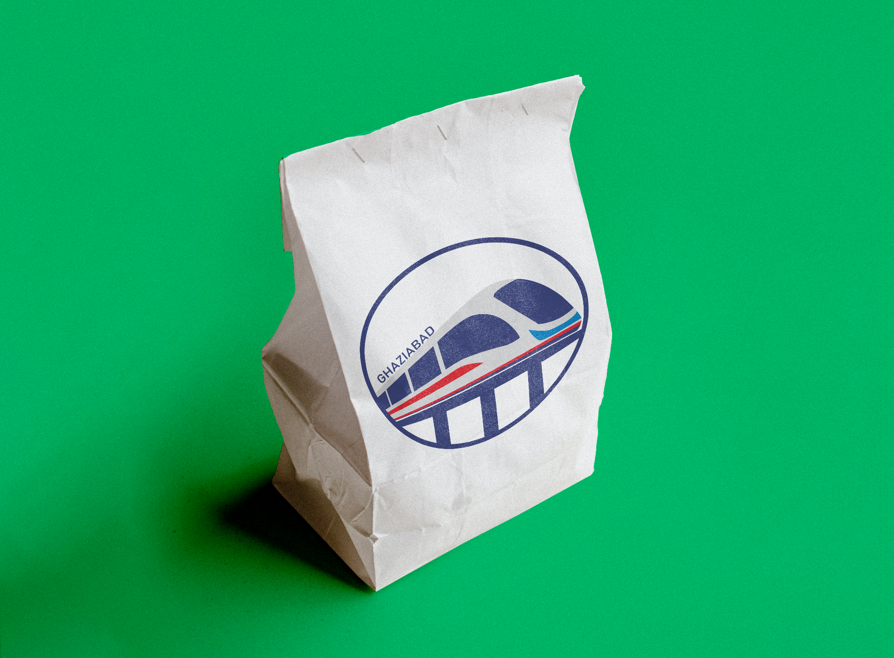

Slide 27
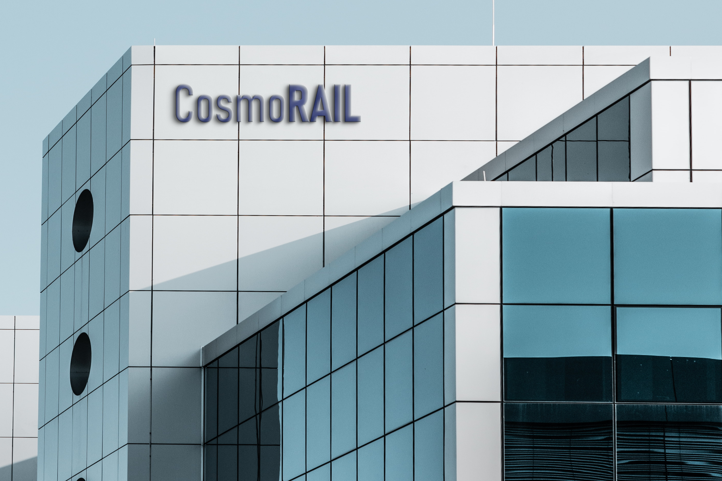

Slide 28
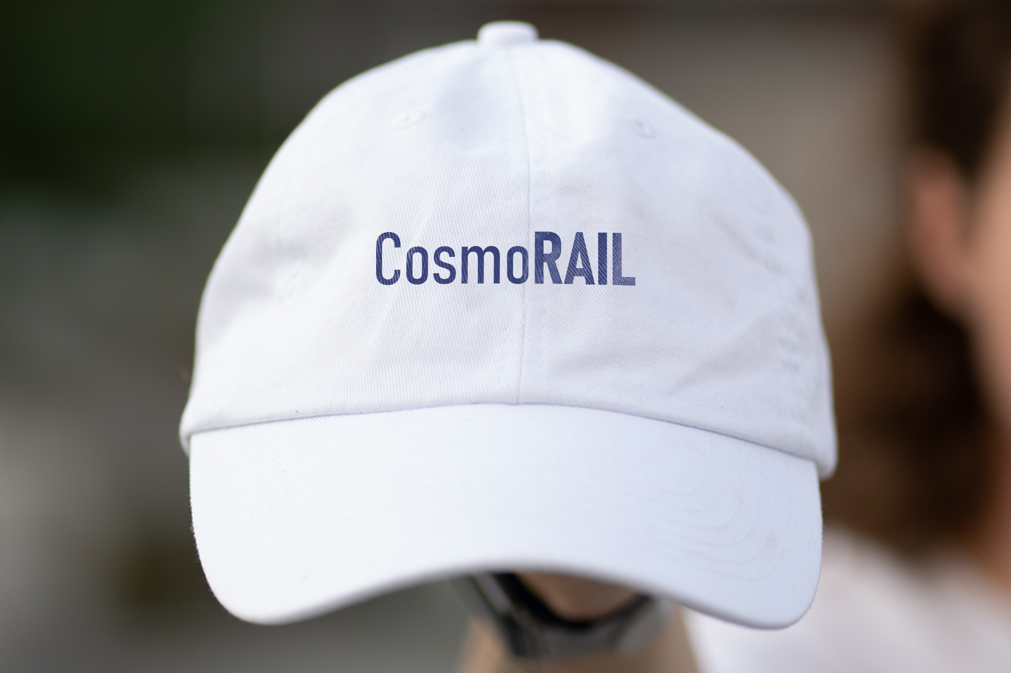

Slide 29
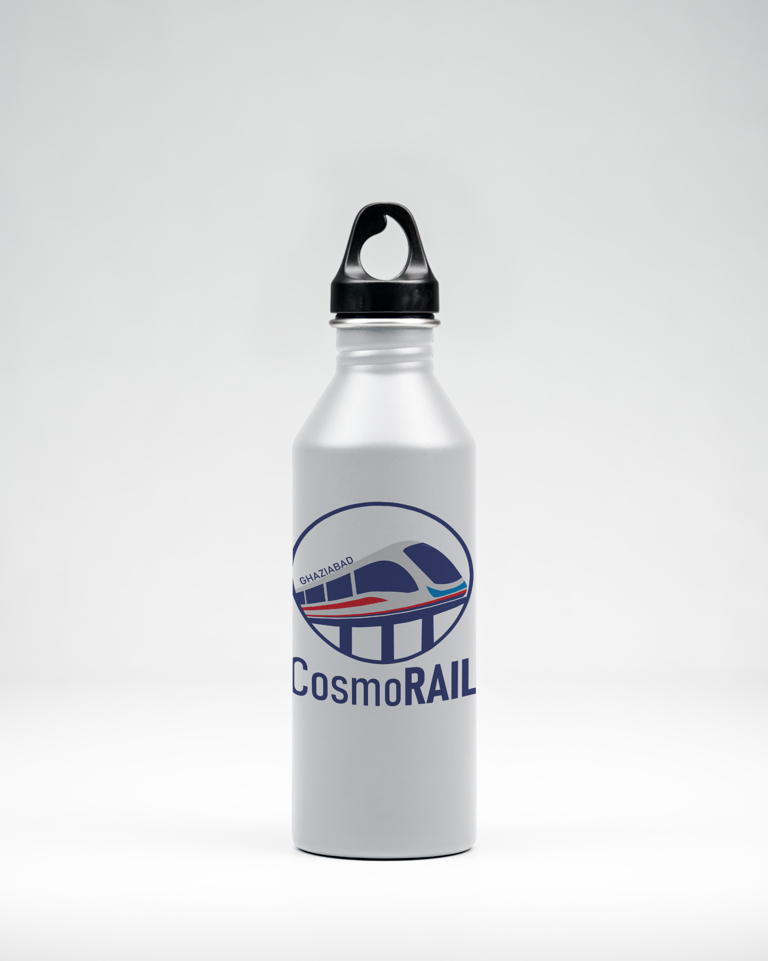

Slide 30
MERCHANDISE
OUR DESIGNS
Tshirt
Cups
Keychain
Bags
Paper Hands Bags
Office Building
Water Bottle
Cap+
All clothing items will contain branding of our company on: -
Fabric
Back Collar Branding

Slide 31
DESIGN MAKING AND TOOLS
05

Slide 32
DESIGN MAKING
Parker Aster Matte Black GT RollerBall Pen
Parker Aster Stainless Steel RollerBall Pen
Parker Vector GT RollerBall Pen
Parker Vector Converse Blue-Gold RollerBall Pen

Slide 33
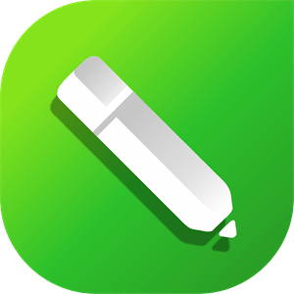
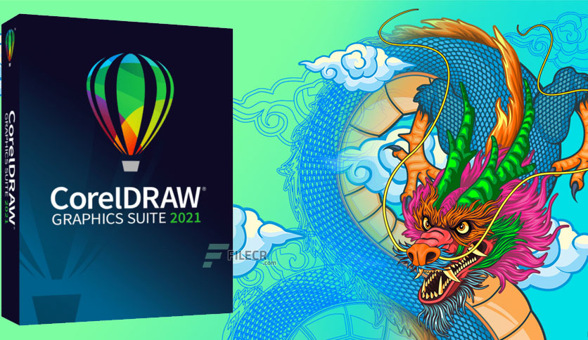
OUR SOFTWARE
CorelDRAW Graphic Suite 2023
Break down creative barriers with CorelDRAW® Graphics Suite 2023 your go-to graphic design software for professional vector illustration, layout, photo editing, and more—on Windows, Mac and web. Effortlessly connect with clients and colleagues to gather feedback on your designs with CorelDRAW. App™
The Volume pricing - Subscribers get more! $269.00* /year per license

Slide 34

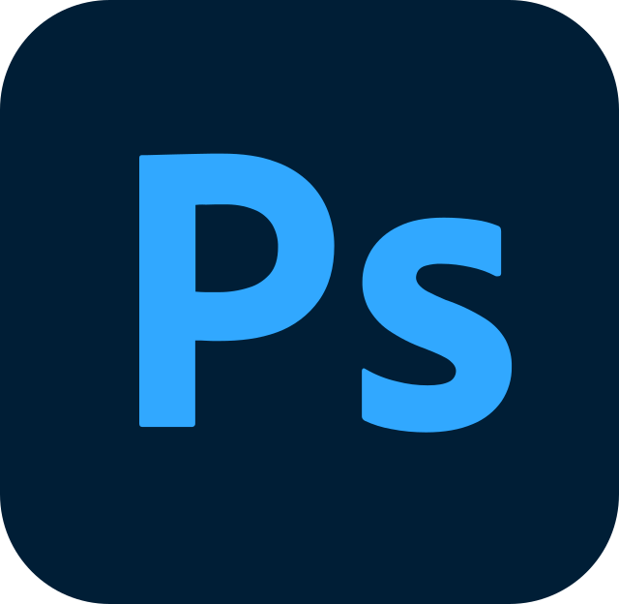
OUR TOOLS
Adobe Photoshop, Adobe Illustrator
Photoshop is the industry-standard photo editing software from small retouching changes to mind-bending photo art. Photoshop is where editors crop photos, adjust photo composition, correct lighting, and make any subject imaginable look its absolute best.
Adobe Illustrator is a vector graphics editor and design program developed and marketed by Adobe Inc.

Slide 35
OUR FUNCTIONS
Pen Tool
Rectangle Tool
Crop tool
PowerClip
Shape(F10) Tool
Smear Tool
Blur Tool
Feather Tool
Page Border
Smart Fill
Interactive Fill
Text Tool
Color Eyedropper
Shadow,Transparency,Distort
RenderEditor

Slide 36
CONCLUSION
06

Slide 37
FOUR IDEAS
PROXIMITY
ORIGINALITY
Proximity to the theme is a important factor which influences the project grade but we have tried our best to satisfy this need to jury.
We have maintained originality in our project by not using any copyrighted content. The content we have used is either buy or non-claimable
CREATIVITY
OVERALL PRESENTATION
We have tried to symbolise our creativity by showing our efforts in color schemes, train designing, bridge designing, fonts, brand naming work, tagline etc.
We have practiced, timed and tried to make the PPT as appealing and as excellent as possible. We have devoted our time and now it's your turn JURY.

Slide 38
It’s Now Yours!
Let’s do it

